Slide 1
Testing

Slide 2
Outline..
Testing
Unit Testing
  Black-Box Testing
  White-Box Testing
Integration Testing
System Testing

Slide 3



Why Test?
Ariane 5 rocket self-destructed 37 seconds after launch
Reason: A software exception bug went undetected…
  Conversion from 64-bit floating point to 16-bit signed integer value had caused an exception
    The floating point number was larger than 32767
    Efficiency considerations had led to the disabling of the exception handler.
Total Cost: over $1 billion

Slide 4
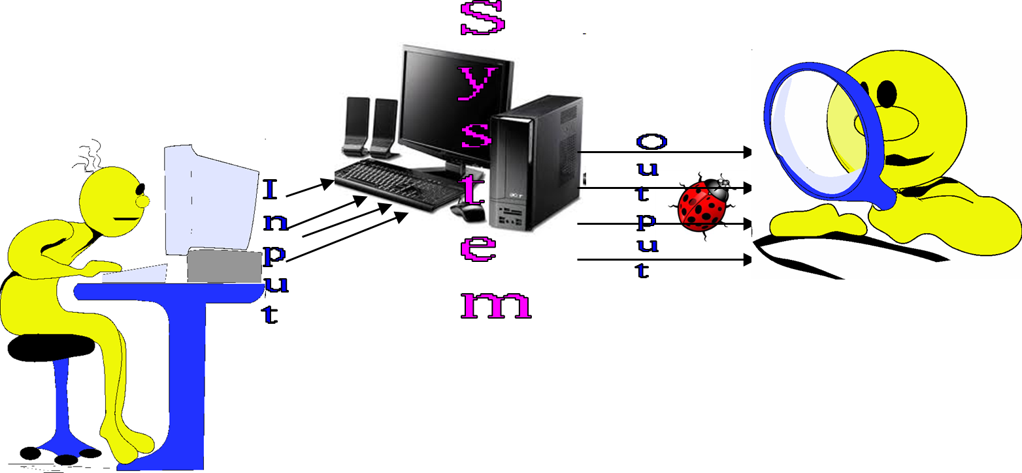
How Do You Test a Program?
Input test data to the program.
Observe the output:
  Check if the program behaved as expected.

Slide 5
Examine Test Result…
If the program does not behave as expected:
  Note the conditions under which it failed (Test report).
  Later debug and correct.

Slide 6
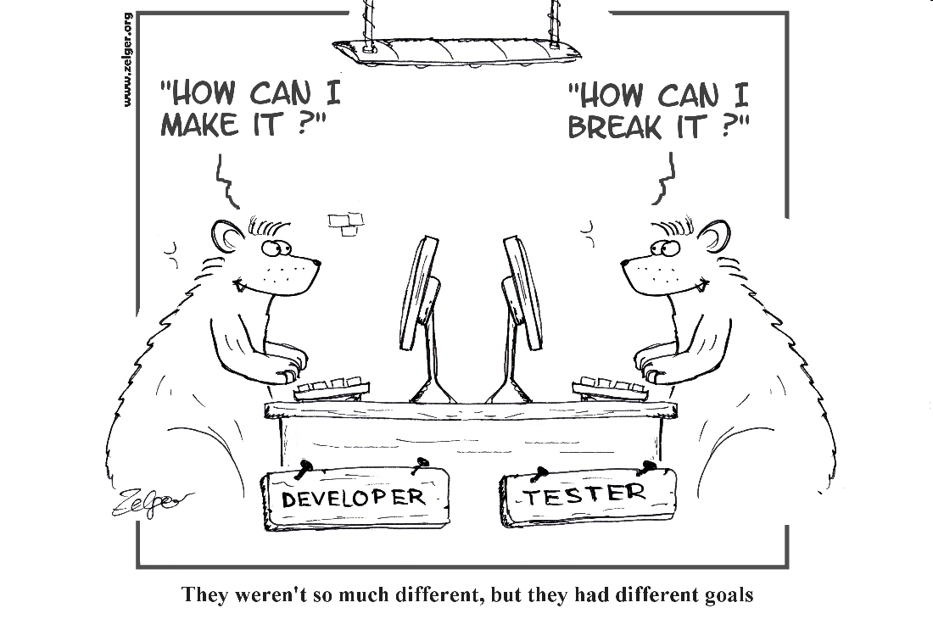
Ack www.zelger.org

Slide 7
What’s So Hard About Testing?
Consider int check-equal(int x, int y)
Assuming a 64 bit computer
  Input space = 2¹²⁸
Assuming it takes 10secs to key-in an integer pair:
  It would take about a billion years to enter all possible values!
  Automatic testing has its own problems!

Slide 8
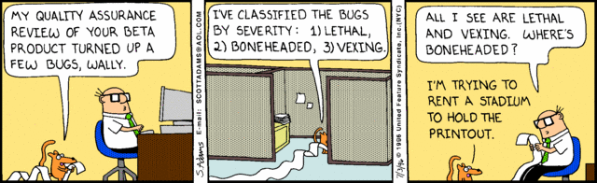
The Test Results are In…
Dilbert: Scott Adams
08/10/1003/08/10

Slide 9

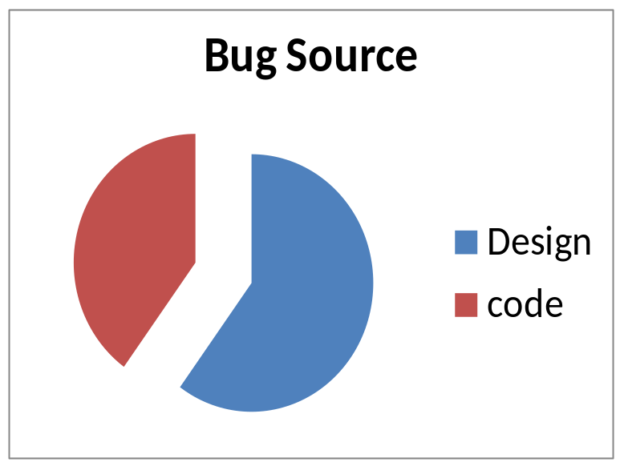
Error Tit-Bits
Experienced programmers on the average make:
  50 errors per 1000 lines of source code
Extensively tested software contains:
  About 1 error per 1000 lines of source code.
Error distribution:
  60% spec/design, 40% implementation.
Notes:
© SE, Testing, Hans van Vliet

Slide 10
Testing Facts
Consumes the largest effort among all development phases:
  Largest manpower among all roles
About 50% development effort
  But 10% of development time?
  How?

Slide 11
Testing Facts
Testing is getting more complex and sophisticated every year.
  Larger and more complex programs
  Newer programming paradigms
  Test automation

Slide 12
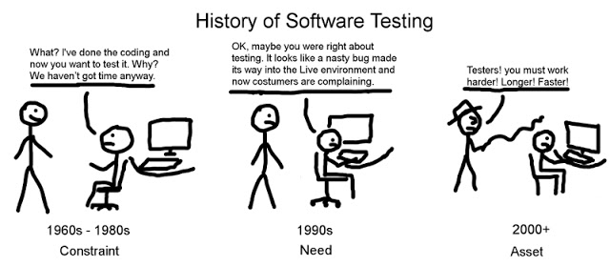
Ack www.dstb.dk

Slide 13
Testing Perception
Testing often viewed as not very challenging --- less preferred by novices, but:
  Over the years testing has taken a center stage in all types of software development.

Slide 14
Terminologies

Slide 15
Mistakes, Error, and Failures
A mistake
  Any programmer action that later shows up as an incorrect result during program execution
Example
  Not initializing a certain variable
  Overlook the errors that might arise in some exceptional situations
    Division by zero in an arithmetic operation

Slide 16
Mistakes, Error, and Failures
An error
  Result of a mistake committed by a developer in any of the development activities
Example
  A call made to a wrong function

Slide 17
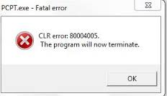
Mistakes, Error, and Failures
A failure
  An incorrect behaviour exhibited by the program during its execution
  A failure is observed during testing:
  A manifestation of an error (also called defect or bug).

Slide 18
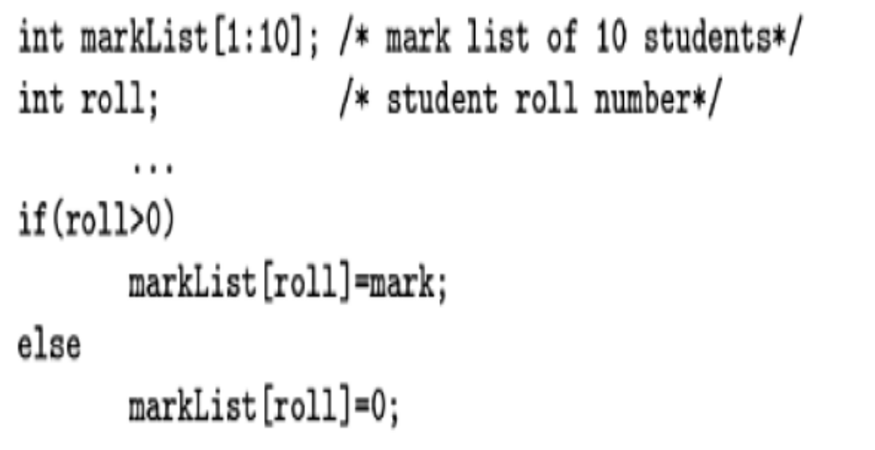
Mistakes, Error, and Failures
Mere presence of an error may not lead to a failure.
Consider the following C program segment:

Slide 19
Mistakes, Error, and Failures
C program Segment…..
zero or some negative value
then an array index out of bound type of error
However , it may be the case that
  for all allowed input values the variable roll is always assigned positive values. Then, the else clause is unreachable and no failure would occur .
  Thus, even if an error is present in the code, it does not show up as an error since it is unreachable for normal input values.

Slide 20
Test Case
In simple words, we can say that a test case is
  a set of test inputs,
  the mode in which the input is to be applied, and
  the results that are expected during and after the execution of the test case.

Slide 21
Test Case
A test case is a triplet [I,S,R]
  I is the data to be input to the system,
  S is the state of the system(execution mode) at which the data will be input,
  R is the expected result of the system.

Slide 22
Test Execution Example: Text Editor
Consider the different execution modes of a certain text editor software—edit, view, create, and display.
An example of a test case is—[input: “abc”, state: edit, result: abc is displayed],
  which essentially means that the input abc needs to be applied in the edit mode, and the expected result is that the string abc would be displayed.

Slide 23
Test Execution Example: Return Book
Test case [I,S,R]
Set the program in the required state: Book record created, member record created, Book issued
Give the defined input: Select renew book option and request renew for a further 2 wk period.
Observe the result and compare to the expected output.

Slide 24
Test Scenario
An abstract test case in the sense that
  It only identifies the aspects of the program that are to be tested without identifying the input, state, or output.
  A test case can be said to be an implementation of a test scenario.
  In the test case, the input, output, and the state at which the input would be applied is designed such that the scenario can be executed.

Slide 25
Test Script
Encoding of a test case as a short program.
Test scripts are developed for
  automated execution of the test cases.

Slide 26
Positive / Negative Test Cases
A test case is said to be a positive test case
  if it is designed to test whether the software correctly performs a required functionality.
A test case is said to be negative test case,
  if it is designed to test whether the software carries out something, that is not required of the system.

Slide 27
What are Negative Test Cases?
Ensures that an application can gracefully handle invalid inputs and unexpected user inputs.
Example:
  If a user tries to type a letter in a numeric field, the correct behavior is to display the message: “Incorrect data type, please enter a number…”
The purpose of negative testing:
  Unexpected inputs are handled satisfactorily and application does not crash.

Slide 28
Positive / Negative Test Cases
Example
Consider a program to manage user login.
A positive test case can be designed to check
  if a login system validates a user with the correct user name and password.
A negative test case in this case can be a test case that checks
  whether the login functionality validates and admits a user with wrong or bogus login user name or password

Slide 29
Test Suite
The set of all test cases
  that have been designed by a tester to test a given program.

Slide 30
Testability
Testability of a requirement denotes
  the extent to which it is possible to determine whether an implementation of the requirement conforms to it in both functionality and performance.
In other words, the testability of a requirement is the degree to which an implementation of it can be adequately tested
  to determine its conformance to the requirement.

Slide 31
Testability
Example: Suppose two programs have been written to implement essentially the same functionality. How can you determine which of these is more testable?
Answer: A program is more testable, if it can be adequately tested with less number of test cases. Obviously, a less complex program is more testable.
Thus, a more testable program should have a lower structural complexity metric.

Slide 32
Failure mode
A failure mode of a software
  denotes an observable way in which it can fail.
In other words, all failures that have similar observable symptoms
  constitute a failure mode.

Slide 33
Failure mode
An example of the failure modes of a software
consider a railway ticket booking software that has
  three failure modes—
    failing to book an available seat,
    incorrect seat booking (e.g., booking an already booked seat), and
    system crash. .

Slide 34
Equivalent faults
Equivalent faults denote
  two or more bugs that result in the system failing in the same failure mode.
Example:
Consider the following two faults in C language—
  division by zero and illegal memory access errors.
These two are equivalent faults, since each of these leads to a program crash.

Slide 35
Verification versus Validation
The objectives of both verification and validation techniques are very similar
  since both these techniques are designed to help remove errors in a software.
In spite of the apparent similarity between their objectives,
  the underlying principles of these two bug detection techniques and their applicability are very different.

Slide 36
Verification versus Validation
Verification is concerned with phase containment of errors:
  Thus, the objective of verification is to check if the work products produced after a phase conform to that which was input to the phase.

Slide 37
Verification versus Validation
Whereas the aim of validation is that the final product be error free.
  Determining whether a fully developed software conforms to its requirements specification

Slide 38
Verification versus Validation
For example,
A verification step can be to check if the design documents produced after the design step conform to the requirements specification.
On the other hand, validation is applied to the fully developed and integrated software to check if it satisfies the customer’s requirements.

Slide 39
Verification | Validation
Are you building it right? | Have you built the right thing?
Checks whether an artifact conforms to its previous artifact. | Checks the final product against the specification.
Done by developers. | Done by Testers.
Static activities: reviews, walkthroughs, and inspections, simultions, testing | Dynamic activities: Execute software and check against requirements.
08/10/1003/08/10

Slide 40
Verification versus Validation
Example
Is it at all possible to develop a highly reliable software, using validation techniques alone?
  If so, can we say that all verification techniques are redundant?

Slide 41
Verification versus Validation
Example
Answer: It is possible to develop a highly reliable software using validation techniques alone.
However , this would cause the development cost to increase drastically.
Verification techniques help achieve phase containment of errors and provide a means to cost-effectively remove bugs.

Slide 42
Verification versus Validation
Error detection techniques =
Verification techniques +
Validation techniques

Slide 43
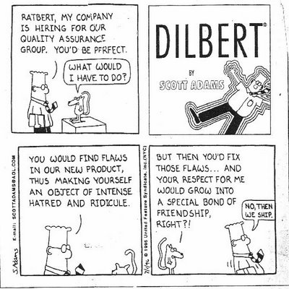
Dilbert: Scott Adams

Slide 44
Testing Activities
Test suite design
Running test cases and checking the results to detect failures
Locate error
Error correction

Slide 45
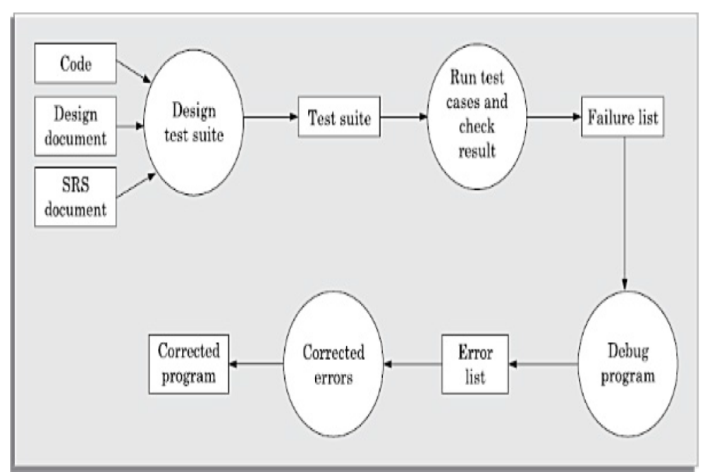
Testing Process

Slide 46
Why Design of Test Cases?
Exhaustive testing of any non-trivial system is impractical:
  Input data domain is extremely large.
Design an optimal test suite:
  Of reasonable size, and
  Uncovers as many errors as possible.

Slide 47
Design of Test Cases
If test cases are selected randomly:
  Many test cases would not contribute to the significance of the test suite,
  Would only detect errors that are already detected by other test cases in the suite.
Therefore, the number of test cases in a randomly selected test suite:
  Not an indication of effectiveness of testing.

Slide 48
Design of Test Cases
Testing a system using a large number of randomly selected test cases:
  Does not mean that many errors in the system will be uncovered.
Consider following example:
  Find the maximum of two integers x and y.

Slide 49
Design of Test Cases
The code has a simple programming error:
If (x>y) max = x;
else max = x; // should be max=y;
Test suite {(x=3,y=2);(x=2,y=3)} can detect the error,
A larger test suite {(x=3,y=2);(x=4,y=3); (x=5,y=1)} does not detect the error.

Slide 50
Design of Test Cases
Systematic approaches are required to design an effective test suite:
  Each test case in the suite should detect different errors.

Slide 51
Test Level

Slide 52
Testing Levels
Software tested at three levels:
  Unit testing
  Integration testing
  System testing

Slide 53
Test Levels
Unit testing
  Test each module (unit, or component) independently
  Mostly done by developers of the modules
Integration testing
  Modules are integrated in steps according to an integration plan
  The partially integrated system is tested at each integration step
system testing
  Test the system as a whole
  Often done by separate testing or QA team

Slide 54
Overview of Activities During System and Integration Testing
Test Suite Design
Run test cases
Check results to detect failures.
Prepare failure list
Debug to locate errors
Correct errors.
Tester
Developer

Slide 55
Quiz 1
As testing proceeds more and more bugs are discovered.
  How to know when to stop testing?
What are the types of bugs detected during:
  Unit testing?
  Integration testing?
  System testing?

Slide 56
Unit Testing
03/08/10

Slide 57
When and Why of Unit Testing?
  Unit testing carried out:
    After coding of a unit is complete and it compiles successfully.
Unit testing reduces debugging effort substantially.

Slide 58
Unit Testing
Before carrying out unit testing
  the unit test cases have to be designed and
  the test environment for the unit under test has to be developed.

Slide 59
Unit Testing
Units testing needs:
  The procedures belonging to other modules that the module under test calls.
  Non-local data structures that the module accesses.
  A procedure to call the functions of the module under test with appropriate parameters.

Slide 60
Unit Testing
  Driver
    Should contain non-local data structures accessed by the module under test.
    Simulates the behavior of a function that calls and possibly supplies some data to the function being tested.
  Stub
    Simulates the behavior of a function that has not yet been written.
    A dummy procedure with highly simplified behavior
Driver
Unit
Stub

Slide 61
Unit Testing
PROCEDURE
UNDER TEST
STUB
DRIVER
CALL
CALL
Access To Nonlocal Variables

Slide 62
Quiz
Unit testing can be considered as which one of the following types of activities?
  Verification
  Validation

Slide 63
Design of Unit Test Cases
There are essentially two main approaches to design test cases:
  Black-box approach
  White-box (or glass-box) approach

Slide 64
Black-Box Testing
Test cases are designed using only functional specification of the software:
  Without any knowledge of the internal structure of the software.
Black-box testing is also known as functional testing.
Input
Output
Software

Slide 65
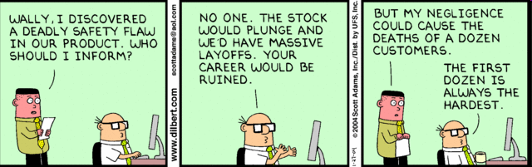
Dilbert: Scott Adams

Slide 66
White-box Testing
To design test cases:
  Knowledge of internal structure of software necessary.
  White-box testing is also called structural testing.

Slide 67
Black-box Testing
03/08/10

Slide 68
Black box testing
Considers the software as a black box:
  Test data derived from the specification
    No knowledge of code necessary
Also known as:
  Data-driven or
  Input/output driven testing

Slide 69
Black-Box Testing
Common approaches to design black box test cases:
  Equivalence class partitioning
  Boundary value analysis

Slide 70
Equivalence Class Testing
03/08/10

Slide 71
Equivalence Class Partitioning
The input values to a program:
  Partitioned into equivalence classes.
Partitioning is done such that:
  Program behaves in similar ways to every input value belonging to an equivalence class.
  At the least there should be as many equivalence classes as scenarios.

Slide 72
Why Define Equivalence Classes?
Test the code with one representative value from each equivalence class:
  Premise: Nearly as good as testing using any other values from an equivalence class.

Slide 73
Equivalence Class Partitioning
How do you identify the equivalence classes?
  Identify scenarios
  Examine the input and output data.
Few guidelines for determining the equivalence classes can be given…

Slide 74
Equivalence Class Partitioning
If the input data to the program is specified by a range of values:
  e.g. numbers between 1 to 5000.
  One valid and two invalid equivalence classes are defined.
1
5000

Slide 75
Equivalence Class Partitioning
If the input data assumes values from a set of discrete members of some domain,
  then one equivalence class for the valid input values and
  another equivalence class for the invalid input values should be defined..

Slide 76
Equivalence Class Partitioning
If input is an enumerated set of values, e.g. : {a,b,c}
Define:
  One equivalence class for valid input values: {a,b,c}
  Another equivalence class for invalid input values should be defined:
  U - {a,b,c}

Slide 77
Example
A program reads an input value in the range of 1 and 5000:
  Computes the square root of the input number
SQRT

Slide 78
Example (cont.)
Three equivalence classes:
  The set of negative integers,
  Set of integers in the range of 1 and 5000,
  Integers larger than 5000.
1
5000

Slide 79
Example (cont.)
The test suite must include:
  Representatives from each of the three equivalence classes:
  A possible test suite can be:
  {-5,500,6000}.
5000
1

Slide 80
Equivalence Partitioning: Example 2
  Design the equivalence class test cases for a program that reads two integer pairs (m1, c1) and (m2, c2) defining two straight lines of the form y=mx+c.
  The program computes the intersection point of the two straight lines and displays the point of intersection.
  {a,b,c}

Slide 81
Equivalence Partitioning: Example 2
  Answer: The equivalence classes are the following:
  • Parallel lines (m1 = m2, c1 <> c2)
  • Intersecting lines (m1 <> m2)
  • Coincident lines (m1 = m2, c1 = c2)
  Test suite:
  {(2,2)(2,5),(5,7)(7,7), (10,10)(10,10)}.
  {a,b,c}

Slide 82
Equivalence Partitioning: Example 3
  Design equivalence class partitioning test suite for a function
    that reads a character string of size less than five characters and displays whether it is a palindrome.
  {a,b,c}

Slide 83
Equivalence Partitioning: Example 3
  Answer:
  The equivalence classes are
    Valid Inputs
      palindromes,
      non-palindromes, and
    invalid inputs.
  Test suite: { aba, abc, abcdef}.

Slide 84
Boundary Value Testing
03/08/10

Slide 85
Boundary Value Analysis
Some typical programming errors occur:
  At boundaries of equivalence classes
Programmers often fail to see:
  Special processing required at the boundaries of equivalence classes.

Slide 86
Boundary Value Analysis
Programmers may improperly use < instead of <=
Boundary value analysis:
  Select test cases at the boundaries of different equivalence classes.

Slide 87
Boundary Value Analysis
Design boundary value test cases:
  Examine Equivalence classes
    that contains a range of values.
    that are not a range of values
      no boundary value test cases can be defined.

Slide 88
Boundary Value Analysis
For an equivalence class that is a range of values,
  the boundary values need to be included in the test suite.
For example, if an equivalence class contains the integers in the range 1 to 10,
  then the boundary value test suite is {0,1,10,11}..

Slide 89
Boundary Value Analysis: Example 1
For a function that computes the square root of the integer values in the range of 0 and 5000, determine the boundary value test suite.

Slide 90
Boundary Value Analysis: Example 1
For a function that computes the square root of the integer values in the range of 0 and 5000, determine the boundary value test suite.
Answer:
  There are three equivalence classes—
    The set of negative integers,
    the set of integers in the range of 0 and 5000,
    the set of integers larger than 5000.
  The boundary value-based test suite is: { -1,0,5000,5001}.

Slide 91
Boundary Value Analysis: Example 2
Design boundary value test suite for a function
  that reads a character string of size less than five characters and displays whether it is a palindrome.
Answer:
  The equivalence classes {aba, abc, abcdef}.
  There is a boundary between the valid and invalid equivalence classes.
  Thus, the boundary value test suite is {abcdefg, abcdef}.

Slide 92
Black Test Suit Design: Summary
Examine the input and output values of the program.
Identify the equivalence classes.
Design equivalence class test cases by picking one representative value from each equivalence class.
Design the boundary value test cases as follows.
  Examine if any equivalence class is a range of values. Include the values at the boundaries of such equivalence classes in the test suite.

Slide 93
White-Box Testing

Slide 94
What is White-box Testing?
White-box test cases designed based on:
  Code structure of program.
  White-box testing is also called structural testing.

Slide 95
White-Box Testing Strategies
Coverage-based:
  Design test cases to cover certain program elements.
Fault-based:
  Design test cases to expose some category of faults

Slide 96
Coverage-Based Testing Versus Fault-Based Testing
Idea behind coverage-based testing:
  Design test cases so that certain program elements are executed (or covered).
  Example: statement coverage, path coverage, branch coverage etc.
Idea behind fault-based testing:
  Design test cases that focus on discovering certain types of faults.
  Example: Mutation testing.

Slide 97
Stronger and Weaker Testing
Stronger
Coverage
Weaker

Slide 98
Stronger Testing
Stronger testing:
  Superset of weaker testing
  A stronger testing covers all the elements covered by a weaker testing.
  Covers some additional elements not covered by weaker testing

Slide 99
Complementary Testing
Coverage
Strategy 1
Strategy 2

Slide 100
Stronger, Weaker, and Complementary Testing
Complementary
Weaker

Slide 101
White-Box Testing
Several white-box testing strategies have become very popular :
  Statement coverage
  Branch coverage
  Path coverage
  Multiple Condition coverage
  Data flow-based testing
  Mutation testing

Slide 102
Statement Coverage
Statement coverage strategy:
  Design test cases so that every statement in the program is executed at least once.

Slide 103
Statement Coverage
The principal idea:
  Unless a statement is executed,
  We have no way of knowing if an error exists in that statement.

Slide 104
Statement Coverage Criterion
However, observing that a statement behaves properly for one input value:
  No guarantee that it will behave correctly for all input values!

Slide 105
Statement Coverage
Coverage measurement:
# executed statements
# statements
Rationale: a fault in a statement can only be revealed by executing the faulty statement
Notes:
12.2 STATEMENT TESTING

Slide 106
Example
int f1(int x, int y){
  1 while (x != y){
  2 if (x>y) then
  3 x=x-y;
  4 else y=y-x;
  5 }
  6 return x; }
Euclid's GCD Algorithm

Slide 107
Euclid's GCD Algorithm
By choosing the test set {(x=4,y=3), (x=3,y=4)}
  All statements are executed at least once.

Slide 108
Branch Coverage
Also called decision coverage.
Test cases are designed such that:
  Each branch condition
    Assumes true as well as false value.

Slide 109
Example
int f1(int x,int y){
1 while (x != y){
2 if (x>y) then
3 x=x-y;
4 else y=y-x;
5 }
6 return x; }

Slide 110
Example
Test cases for branch coverage can be:
{(x=3,y=3),(x=3,y=2), (x=4,y=3), (x=3,y=4)}

Slide 111
Branch Testing
Adequacy criterion: Each branch (edge in the CFG) must be executed at least once
Coverage:
# executed branches
# branches

Slide 112
Quiz 1: Branch and Statement Coverage: Which is Stronger?
Branch testing guarantees statement coverage:
  A stronger testing compared to the statement coverage-based testing.

Slide 113
Statements vs Branch Testing
Traversing all edges of a graph causes all nodes to be visited
  So a test suite that satisfies branch adequacy criterion also satisfies statement adequacy criterion for the same program.
The converse is not true:
  A statement-adequate (or node-adequate) test suite may not be branch-adequate (edge-adequate).
Notes:
The example of two slides ago illustrates this point

Slide 114
All Branches can still miss conditions
Sample fault: missing operator (negation)
digit_high == 1 || digit_low == -1
Branch adequacy criterion can be satisfied by varying only digit_low
  The faulty sub-expression might not be tested!
  Even though we test both outcomes of the branch
Notes:
Recall we’re trying to exercise each of the significant cases in the code. A single
branch statement (“if”, “while”, etc.) may actually combine different cases in a
complex condition, and exercising both outcomes of the branch may not exercise
each part of the complex condition.

Slide 115
Condition Coverage
Also called multiple condition (MC) coverage .
Test case design:
  Each component of a composite conditional expression
    Made to assumes both true and false values.

Slide 116
Example
Consider the conditional expression
  ((c1.and.c2).or.c3):
Each of c1, c2, and c3 are exercised at least once,
  That is, given true and false values.

Slide 117
Basic condition testing
Adequacy criterion: each basic condition must be executed at least once
Coverage:
# truth values taken by all basic conditions
2 * # basic conditions
Notes:
the total number of truth values that the basic conditions can take is twice the number of basic conditions, since each basic condition can assume value true or false

Slide 118
Example
Give an example of a fault that is detected by multiple condition coverage, but not by branch coverage.
Answer: Consider the following C program segment:
  if(temperature>150 || temperature>50) setWarningLightOn();

Slide 119
Example
The program segment has a bug in the second component condition,
  it should have been temperature<50.
Test suite {temp.=160, temp.=40}
  achieves branch coverage.
  But, it is not able to check that
    setWarningLightOn(); should not be called for temperature values within 150 and 50.

Slide 120
Multiple Condition Testing
Condition testing:
  Stronger testing than branch testing.
Branch testing:
  Stronger than statement coverage testing.
Multiple Condition
Decision
Statement

Slide 121
Path Coverage
Design test cases such that:
  All linearly independent paths in the program are executed at least once.
Defined in terms of
  Control flow graph (CFG) of a program.

Slide 122
Path Coverage-Based Testing
To understand the path coverage-based testing:
  We need to learn how to draw control flow graph of a program.
A control flow graph (CFG) describes:
  The sequence in which different instructions of a program get executed.
  The way control flows through the program.

Slide 123
How to Draw Control Flow Graph?
Number all statements of a program.
Numbered statements:
  Represent nodes of control flow graph.
An edge from one node to another node exists:
  If execution of the statement representing the first node can
    result in transfer of control to the other node.

Slide 124
How to Draw Control flow Graph?
Every program is composed of:
  Sequence
  Selection
  Iteration
If we know how to draw CFG corresponding these basic statements:
  We can draw CFG for any program.

Slide 125
How to Draw Control flow Graph?
Sequence:
  1 a=5;
  2 b=a*b-1;
1
2

Slide 126
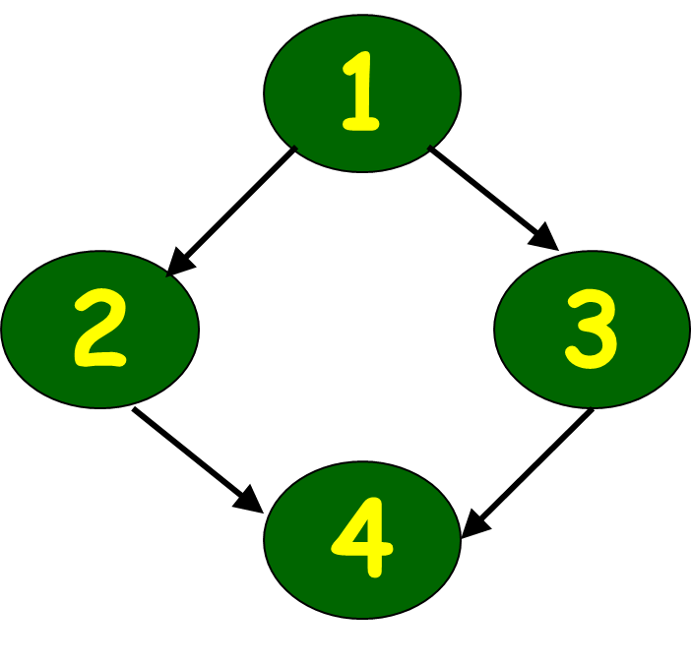
How to Draw Control Flow Graph?
Selection:
  1 if(a>b) then
  2 c=3;
  3 else c=5;
  4 c=c*c;

Slide 127
How to Draw Control Flow Graph?
Iteration:
  1 while(a>b){
  2 b=b*a;
  3 b=b-1;}
  4 c=b+d;
1
2
3
4

Slide 128
Example
int f1(int x,int y){
1 while (x != y){
2 if (x>y) then
3 x=x-y;
4 else y=y-x;
5 }
6 return x; }

Slide 129
Example Control Flow Graph
1
2
3
4
5
6

Slide 130
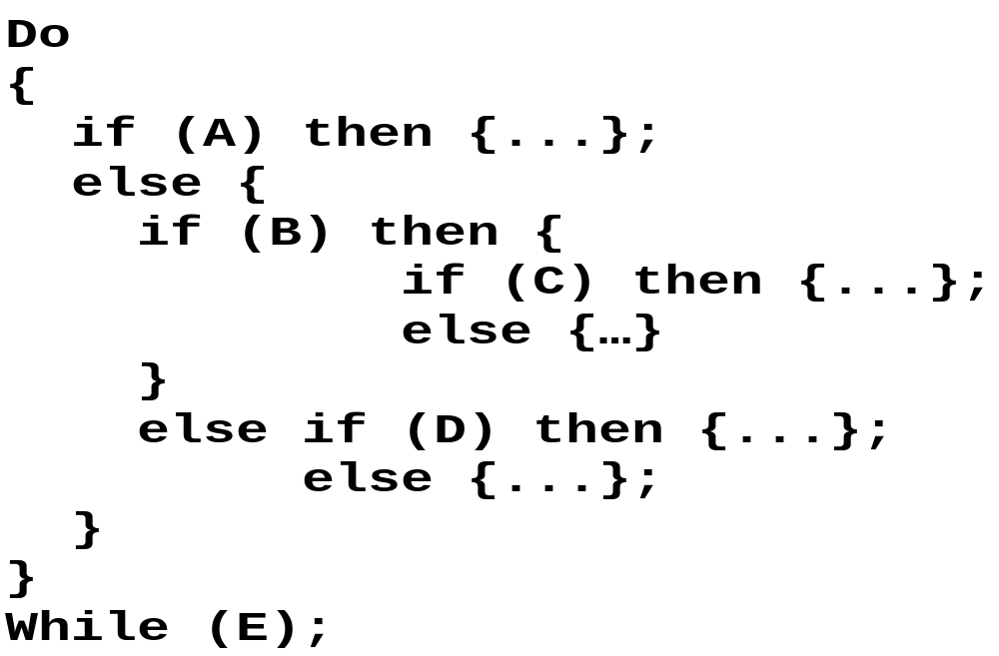
Example Code Fragment

Slide 131
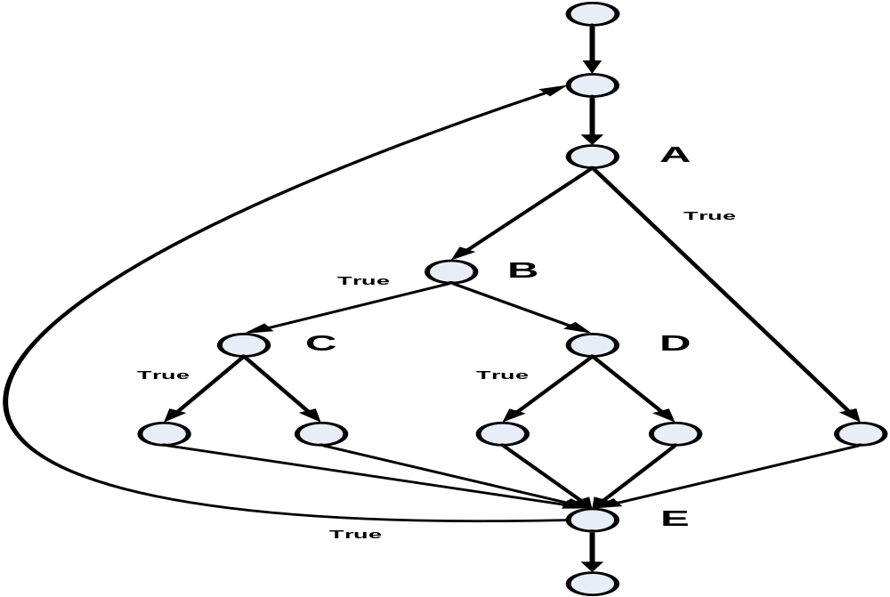
Example Control Flow Graph
Source: The Art of Software Testing – Glenford Myers

Slide 132
Path
A path through a program:
  A node and edge sequence
    from the starting node to a terminal node of the control flow graph.
  There may be several terminal nodes for program.

Slide 133
Linearly Independent Path
Any path through the program that:
  Introduces at least one new edge:
    Not included in any other independent paths.

Slide 134
Linearly Independent Path
1
16
123516
124516.
2
3
4
5
6

Slide 135
Linearly Independent Path
It is straight forward:
  To identify linearly independent paths of simple programs.
For complicated programs:
  It is not easy to determine the number of independent paths.

Slide 136
McCabe's Cyclomatic Metric
An upper bound:
  For the number of linearly independent paths of a program
Provides a practical way of determining:
  The maximum number of linearly independent paths in a program.

Slide 137
McCabe's Cyclomatic Metric
Method 1:
Given a control flow graph G,
cyclomatic complexity V(G):
  V(G)= E-N+2
    N is the number of nodes in G
    E is the number of edges in G

Slide 138
Example Control Flow Graph
1
Cyclomatic complexity =
7-6+2 = 3.
2
3
4
5
6

Slide 139
Cyclomatic Complexity
Method 2:
Another way of computing cyclomatic complexity:
  inspect control flow graph
  determine number of bounded areas in the graph
V(G) = Total number of bounded areas + 1
  Any region enclosed by a nodes and edge sequence.

Slide 140
Example Control Flow Graph
1
2
3
4
5
6

Slide 141
Example
From a visual examination of the CFG:
  Number of bounded areas is 2.
  Cyclomatic complexity = 2+1=3.

Slide 142
Cyclomatic Complexity
Method 3:
It can also be easily computed by computing
  the number of decision and loop statements of the program.
If N is the number of decision and loop statements of a program,
  then the McCabe’s metric
    is equal to N + 1.

Slide 143
Example Control Flow Graph
1
Cyclomatic complexity =
2+1 = 3.
2
3
4
5
6

Slide 144
Cyclomatic Complexity
McCabe's metric provides:
    A quantitative measure of testing difficulty and the ultimate reliability
Intuitively,
  Number of bounded areas increases with
    the number of decision nodes and loops.

Slide 145
Cyclomatic Complexity
The first method of computing V(G) is amenable to automation:
  You can write a program which determines the number of nodes and edges of a graph
  Applies the formula to find V(G).

Slide 146
Cyclomatic Complexity
The cyclomatic complexity of a program provides:
  A lower bound on the number of test cases to be designed
  To guarantee coverage of all linearly independent paths.

Slide 147
Derivation of Test Cases
Draw control flow graph.
Determine V(G).
Determine the set of linearly independent paths.
Prepare test cases:
  Force execution along each path.
  Not practical for larger programs.

Slide 148
Example
int f1(int x,int y){
1 while (x != y){
2 if (x>y) then
3 x=x-y;
4 else y=y-x;
5 }
6 return x; }

Slide 149
Example Control Flow Diagram
1
2
3
4
5
6

Slide 150
Derivation of Test Cases
Number of independent paths: 3
  1,6 test case (x=1, y=1)
  1,2,3,5,1,6 test case(x=1, y=2)
  1,2,4,5,1,6 test case(x=2, y=1)

Slide 151
An Interesting Application of Cyclomatic Complexity
Relationship exists between:
  McCabe's metric
  The number of errors existing in the code,
  The time required to find and correct the errors.

Slide 152
Cyclomatic Complexity
Cyclomatic complexity of a program:
  Also indicates the psychological complexity of a program.
  Difficulty level of understanding the program.

Slide 153
Cyclomatic Complexity
From maintenance perspective,
  Limit cyclomatic complexity of modules
    To some reasonable value.
  Good software development organizations:
    Restrict cyclomatic complexity of functions to a maximum of ten or so.

Slide 154
White-Box Testing : Summary
weakest
statement
coverage
branch
(or decision)
coverage
multiple- condition
coverage
strongest
path
coverage

Slide 155
Data Flow-Based Testing
Selects test paths of a program:
  According to the locations of
    Definitions and uses of different variables in a program.

Slide 156
Data Flow-Based Testing
For a statement numbered S,
  DEF(S) = {X/statement S contains a definition of X}
  USES(S)= {X/statement S contains a use of X}
  Example: 1: a=b; DEF(1)={a}, USES(1)={b}.
  Example: 2: a=a+b; DEF(2)={a}, USES(2)={a,b}.

Slide 157
Data Flow-Based Testing
A variable X is said to be live at statement S1, if
  X is defined at a statement S:
  There exists a path from S to S1 not containing any definition of X.

Slide 158
DU Chain Example
1 X(){
2 a=5; /* Defines variable a */
3 While(C1) {
4 if (C2)
5 b=a*a; /*Uses variable a */
6 a=a-1; /* Defines variable a */
7 }
8 print(a); } /*Uses variable a */
[a,1,5]: a DU chain

Slide 159
Definition-use chain (DU chain)
[X,S,S1],
  S and S1 are statement numbers,
  X in DEF(S)
  X in USES(S1), and
  the definition of X in the statement S is live at statement S1.

Slide 160
Data Flow-Based Testing
One simple data flow testing strategy:
  Every DU chain in a program be covered at least once.
Data flow testing strategies:
  Useful for selecting test paths of a program containing nested if and loop statements.

Slide 161
Mutation Testing
In this, software is first tested:
  Using an initial test suite designed using white-box strategies.
After the initial testing is complete,
  Mutation testing is taken up.
The idea behind mutation testing:
  Make a few arbitrary small changes to a program at a time.

Slide 162
Main Idea
Insert faults into a program:
  Check whether the test suite is able to detect these.
  This either validates or invalidates the test suite.

Slide 163
Mutation Testing
Each time the program is changed,
  It is called a mutated program
  The change is called a mutant.

Slide 164
Mutation Testing
A mutated program:
  Tested against the full test suite of the program.
If there exists at least one test case in the test suite for which:
  A mutant gives an incorrect result,
  Then the mutant is said to be dead.

Slide 165
Mutation Testing
If a mutant remains alive:
  Even after all test cases have been exhausted,
  The test suite is enhanced to kill the mutant.
The process of generation and killing of mutants:
  Can be automated by predefining a set of primitive changes that can be applied to the program.

Slide 166
Mutation Testing
The primitive changes can be:
  Deleting a statement / var definition
  Altering an arithmetic/logical operator,
  Changing the value of a constant,
  Changing a data type, etc.
  It is the types of faults possible in a program.

Slide 167

The Mutation Process
Program
If program is not error-free, fix it
Create Mutants
Test Process
Mutation
Tests
Problem with Tests?
Mutation
New Test Cases
Mutant
Test Mutants
Mutants that are
caught by tests are killed
Yes
Any Live Mutants?
Test Complete
No

Slide 168
Disadvantages of Mutation Testing
Computationally very expensive.
A large number of possible mutants can be generated.
Certain types of faults are very difficult to inject.

Slide 169
Debugging

Slide 170
Debugging
Once errors are identified:
  Debug: Identify precise location of errors
  Fix errors
Each debugging approach has its advantages and disadvantages:
  Each is useful in appropriate circumstances.

Slide 171
Brute-Force Method
This is the most common method of debugging:
  Least efficient method.
  Program is loaded with print statements
  Print the intermediate values
  Hope that some of printed values will help identify the error.

Slide 172
Symbolic Debugger
Using a symbolic debugger:
  Values of different variables can be easily checked.
    Break points and watch points can be set to test the values of variables.
  Single stepping to execute one instruction at a time

Slide 173
Backtracking
This is a fairly common approach.
Beginning at the statement where an error symptom has been observed:
  Source code is traced backwards until the error is discovered.

Slide 174
Example
int main(){
int i,j,s;
i=1;
while(i<=10){
s=s+i;
i++; j=j++;}
printf(“%d”,s);
}

Slide 175
Backtracking
Unfortunately, as the number of source lines to be traced back increases,
  The number of potential backward paths increases
  Becomes unmanageably large for complex programs.

Slide 176
Cause-Elimination Method
Determine a list of causes:
  which could possibly have contributed to the error symptom.
  tests are conducted to eliminate each.

Slide 177
Program Slicing
This technique is similar to back tracking.
  However, the search space is reduced by defining slices.
A slice is defined for a particular variable at a particular statement:
  Set of source lines preceding this statement which can influence the value of the variable.

Slide 178
Example
int main(){
int i,s;
i=1; s=1;
while(i<=10){
s=s+i;
i++;}
printf(“%d”,s);
printf(“%d”,i);
}

Slide 179
Debugging Guidelines
Debugging requires a thorough understanding of program design.
Debugging may sometimes require full redesign of the program.
A common mistake novice programmers often make:
  Not fixing the error but the error symptoms.

Slide 180
Debugging Guidelines
Be aware of the possibility:
  An error correction may introduce new errors.
After every round of error-fixing:
  Regression testing must be carried out.

Slide 181
Program Analysis Tools

Slide 182
Program Analysis Tools
An automated (static) tool:
  Takes program source code / executable code as input
  Produces reports regarding several important characteristics of the program

Slide 183
Program Analysis Tools
  Important characteristics of the program, Such as
    size,
    complexity,
    adequacy of commenting,
    adherence to programming standards,
    adequacy of testing etc.

Slide 184
Program Analysis Tools
There are essentially two categories of program analysis tools:
  Static analysis tools
  Dynamic analysis tools

Slide 185
Static Analysis Tools
Static analysis tools:
  Assess properties of a program without executing it.
  Analyze the source code to certain analytical conclusions.

Slide 186
Static Analysis Tools
Analyse the source code
  To compute source code metrics:
    Size; cyclomatic complexity etc.
  Report certain analytical conclusions
  Also, check the conformance of the code
    with the prescribed coding standards

Slide 187
Static Analysis Tools
Displays following analysis results
To what extent:
  Coding standards been adhered to?
Programming errors such as:
  Uninitialized variables
  Mismatch between actual and formal parameters.
  Variables declared but never used, etc.

Slide 188
Static Analysis Tools
Can code walk through and inspection be considered as static analysis methods?
  The term static program analysis is generally used for automated analysis tools.

Slide 189
Dynamic Analysis Tools
Dynamic program analysis tools require the program to be executed:
  Record and analyse
    Actual behaviour of a program while it is being executed

Slide 190
Dynamic Analysis Tools
Collects execution trace information by instrumenting the code.
  Inserting additional statements
    to print the values of certain variables into a file.

Slide 191
Dynamic Analysis Tools
Post Execution Analysis Report:
  Coverage achieved by test suite
    Statement
    Branch
    Path coverage etc.
  Helps in designing additional test cases /
  eliminate redundant test cases

Slide 192
Integration Testing

Slide 193
Integration Testing
Carried out
  After all / some of the modules have been unit tested
Objective:
  To detect the errors at the module interfaces (call parameters)

Slide 194
Integration Testing
Integration Plan
  Steps and the order in which the modules are combined to realize the full system
    Module dependency graph from structure chart
  After each integration step
    Test partially integrated system

Slide 195
Integration Testing Approaches
Develop the integration plan by examining the structure chart :
  big bang approach
  top-down approach
  bottom-up approach
  mixed approach

Slide 196
Example Structured Design
root
Valid-numbers
rms
rms
Valid-numbers
Get-good-data
Compute-
solution
Display-solution
Get-
data
Validate-data

Slide 197
Big Bang Integration Testing
Big bang approach is the simplest integration testing approach:
  All the modules are simply put together and tested.
  This technique is used only for very small systems.

Slide 198
Big Bang Integration Testing
Main problems with this approach:
  If an error is found:
    It is very difficult to localize the error
    The error may potentially belong to any of the modules being integrated.
  Debugging errors found during big bang integration testing are
    very expensive to fix.

Slide 199
Bottom-up Integration Testing
Large software made up of several small subsystems.
  A subsystem with many modules
Bottom-up
  Integrate modules of each subsystem
  Integrate subsystems

Slide 200
Bottom-up Integration Testing
Very Large software
  may require Several levels of subsystem testing
  Lower level subsystems are
    Successfully combined to form higher-level subsystems

Slide 201
Bottom-up Integration Testing
Advantage of bottom-up testing:
  Several disjoint subsystems can be tested simultaneously
  Low-level modules get tested thoroughly

Slide 202
Bottom-up Integration Testing
A disadvantage of bottom-up testing:
  Complexity that occurs when the system is made up of
    a large number of small subsystems.
    That are at the same level
  This extreme case corresponds to the big bang approach.

Slide 203
Top-down Integration Testing
Top-down integration testing starts with the main routine:
  and one or two subordinate routines in the system.
After the top-level 'skeleton’ has been tested:
  immediate subordinate modules of the 'skeleton’ are combined with it and tested.

Slide 204
Mixed Integration Testing
Mixed (or sandwiched) integration testing:
  Uses both top-down and bottom-up testing approaches.
  Most common approach

Slide 205
Mixed Integration Testing
In top-down approach:
  Testing waits till all top-level modules are coded and unit tested.
In bottom-up approach:
  Testing can start only after bottom level modules are ready.

Slide 206
Incremental vs Phased Integration Testing
Incremental:
  One new module is added each time
Phased:
  Group of related modules are added

Slide 207
Problem
58. Draw the control flow graph for the following function named find-maximum. From the control flow graph, determine its cyclomatic complexity.
int find-maximum(int i,int j, int k)
{ int max;
if(i>j) then
if(i>k) then max=i;
else max=k;
else if(j>k) max=j
else max=k;
return(max);
}

Slide 208
Example Control Flow Graph
1
2
3
4
5
6

Slide 209
Soln.
Number the statements:
int find-maximum(int i,int j, int k)
{ int max;
1 if(i>j) then
2 if(i>k) then
3 max=i;
4 else max=k;
5 else if(j>k)
6 max=j
7 else max=k;
8 return(max);
}

Slide 210
Soln.
Cyclomatic Complexity:
Method 1: E-N+2 = 10-8 +2 =4
Method 2: No. of bounding areas + 1
= 3+1 = 4
Method 3: No. of decision and loop statements
+ 1
=3+1 =4

Slide 211
Problem
59. Suppose a C program has 240 sequence type of statements, 50 selection type of statements and 40 iteration type of statements, determine the minimum number of test cases required for path testing.

Slide 212
Soln.
Method 3: 50+40+1 = 91.

Slide 213
Problem
Design a test suite for the function find-maximum(Problem 58) that satisfies the Path Coverage strategy .

Slide 214
Soln.
Linearly Independent Paths Test Cases
1238 i=5, j=4, k=3
1248 i=5, j=4, k=10
1568 i=5, j=15, k=10
1578 i=5, j=10, k=15

Slide 215
System Testing

Slide 216
System Testing
Integration Testing
  → System Testing
Validate fully developed system
  Test Cases based on SRS
  Independent of implementation

Slide 217
System Testing
There are three main types of system testing:
  Alpha Testing
  Beta Testing
  Acceptance Testing

Slide 218
Alpha Testing
System testing carried out by the test team within the developing organization.
  Test cases are designed based on the SRS document

Slide 219
Beta Testing
System testing performed by a
  select group of friendly customers.

Slide 220
Acceptance Testing
System testing performed by the customer himself:
  To determine whether the system should be accepted or rejected.

Slide 221
System Testing
Smoke Testing
Functionality Testing
Performance Testing

Slide 222
System Testing
Smoke Testing
  to check whether at least the main functionalities of the software are working

Slide 223
System Testing
Smoke Testing
  If the integrated program cannot pass even the basic tests
    it is not ready for a vigorous testing.

Slide 224
System Testing
Smoke Testing
  For example, for a library automation system, smoke tests may check
    whether books can be created and deleted,
    whether member records can be created and deleted, and
    whether books can be loaned and returned.

Slide 225
System Testing
Performance Testing
  check whether the system meets
    the nonfunctional requirements.
  Types of performance testing to be carried out on a system depends on
    the different non-functional requirements of the system documented in SRS document.
  All performance tests can be considered as black-box tests.

Slide 226
System Testing
Performance Testing
  Stress Testing
  Volume Testing
  Configuration Testing
  Compatibility Testing
  Regression Testing
  Recovery Testing
  Maintenance Testing
  Documentation Testing
  Usability Testing
  Security Testing

Slide 227
Stress Testing
Stress testing (also called endurance testing):
  Impose abnormal input to stress the capabilities of the software.
  Input data volume, input data rate, processing time, utilization of memory, etc. are tested beyond the designed capacity.

Slide 228
Stress Testing
Stress testing is especially important for systems
  that under normal circumstances operate below their maximum capacity
  but may be severely stressed at some peak demand hours.

Slide 229
Stress Testing
  For example
    the response time should not be more than twenty secs per transaction
      when sixty concurrent users are working,
    then during stress testing the response time is checked
      with exactly sixty users working simultaneously

Slide 230
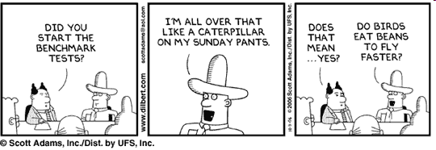
Dilbert: Scott Adams

Slide 231
Configuration Testing
  Sometimes systems are built to work in different configurations for different users.
  Configuration testing is used
    to test system behaviour in various hardware and software configurations specified in the requirements.

Slide 232
Configuration Testing
  For instance, a minimal system might be required to serve a single user, and
  other extended configurations may be required to serve additional users during configuration testing.

Slide 233
Compatibility Testing
  Required when the system interfaces with external systems (e.g., databases, servers, etc.).
  Compatibility aims to check
    whether the interfaces with the external systems are performing as required.

Slide 234
Compatibility Testing
  For instance, if the system needs to communicate with a large database system to retrieve information,
  compatibility testing is required to test the speed and accuracy of data retrieval.

Slide 235
Regression Testing
Regression testing is testing done to check that a system update does not cause
  new errors or re-introduce errors that have been corrected earlier.

Slide 236
Need for Regression Testing
Any system during use undergoes frequent code changes.
  Corrective, Adaptive, and Perfective changes.
Regression testing needed after every change:
  Ensures unchanged features continue to work fine.

Slide 237
Recovery Testing
Recovery testing tests the response of the system to
  loss of power, devices, services, data, etc.

Slide 238
Recovery Testing
The system is subjected to the loss of the mentioned resources (as discussed in the SRS document) and
  it is checked if the system recovers satisfactorily.
For example, the power may be shut down
  to check the extent of data loss and corruption.

Slide 239
Maintenance Testing
This addresses testing the diagnostic programs, and other procedures
  that are required to help maintenance of the system.
It is verified that
  the artifacts exist and they perform properly.

Slide 240
Documentation Testing
It is checked whether the required user manual, maintenance manuals, and technical manuals
  exist and are consistent.
If the requirements specify the types of audience for which a specific manual should be designed,
  then the manual is checked for compliance of this requirement.

Slide 241
Usability Testing
Usability testing concerns checking the user interface to see
  if it meets all user requirements concerning the user interface.
During usability testing,
  the display screens, messages, report formats, and other aspects relating to the UI requirements are tested.

Slide 242
Security Testing
Security testing is essential for software
  that handle or process confidential data that is to be gurarded against pilfering.
It needs to be tested whether the system is fool-proof
  from security attacks such as intrusion by hackers.

Slide 243
Security Testing
Over the last few years, a large number of security testing techniques have been proposed, and these include
  password cracking,
  penetration testing, and
  attacks on specific ports, etc.

Slide 244
Error Seeding

Slide 245
Error Seeding
Sometimes customers specify the
  maximum number of residual errors that can be present in the delivered software.
These requirements are often expressed in terms of
  maximum number of allowable errors per line of source code.

Slide 246
Error Seeding
The error seeding technique can be used to
  Estimate the number of residual errors in a software
Make a few arbitrary changes to the program:
  Artificial errors are seeded into the program.
  Check how many of the seeded errors are detected during testing.

Slide 247
Error Seeding
Let:
  N be the total number of errors in the system
  n of these errors be found by testing.
  S be the total number of seeded errors,
  s of the seeded errors be found during testing.

Slide 248
Error Seeding
n/N = s/S
N = S n/s
remaining defects:
N - n = n ((S - s)/ s)

Slide 249
Exercise
100 errors were introduced.
90 of these errors were found during testing
50 other errors were also found.
Find errors remaining in code.

Slide 250
Exercise : Solution
100 errors were introduced.
90 of these errors were found during testing
50 other errors were also found.
Remaining errors=
50 (100-90)/90 = 6

Slide 251
Error Seeding
The kinds of seeded errors should match closely with existing errors:
  However, it is difficult to predict the types of errors that exist.
Categories of remaining errors:
  Can be estimated by analyzing historical data from similar projects.

Slide 252
Testing Object-Oriented Programs

Slide 253
Introduction
It was expected during initial years that OO would help substantially reduce testing effort:
  But, as we shall find it out ---
    it only complicates testing.

Slide 254
Challenges in OO Testing
What is an appropriate unit for testing?
Implications of OO features:
  Encapsulation
  Inheritance
  Polymorphism & Dynamic Binding, etc.
State-based testing
Test coverage analysis
Integration strategies

Slide 255
What is a Suitable Unit for Testing?
What is the fundamental unit of testing for conventional programs?
  A function.
As far as OO programs are concerned:
  Methods are not the basic unit of testing!
Weyukar's Anticomposition axiom:
  Any amount of testing of individual methods can not ensure that a class has been satisfactorily tested.

Slide 256
Suitable Unit for Testing OO Programs
A method operates in the scope of the data and other methods of its object.
That is, all the methods share the data of the class.
Therefore, it is necessary to test a method in the context of these.

Slide 257
Suitable Unit for Testing OO Programs
Moreover , objects can have
  significant number of states.
The behaviour of a method can be different
  based on the state of the corresponding object.

Slide 258
Suitable Unit for Testing OO Programs
A method has to be tested with
  all the other methods and data of the corresponding object.
Moreover, a method needs to be tested at
  all the states that the object can assume.

Slide 259
Suitable Unit for Testing OO Programs
An object is the
  basic unit of testing of object-oriented programs

Slide 260
Suitable Unit for Testing OO Programs
Thus, in an object oriented program, unit testing would mean
  testing each object in isolation.
During integration(cluster) testing
  various unit tested objects are integrated and tested.
Finally, system-level testing is carried out

Slide 261
OO Features and Testing

Slide 262
Encapsulation
Encapsulation is not a source of errors:
  However, an obstacle to testing.
  It prevents accessing attribute values by a debugger.
While testing:
  Precise information about current state is necessary.
  Built-in or inherited state reporting methods.

Slide 263
Inheritance
The inheritance feature helps in
  code reuse and was expected to simplify testing.
It was expected that if a class is tested thoroughly
  then the classes that are derived from this class would need
    only incremental testing of the added features.

Slide 264
Should Inherited Methods be Retested?
Retesting required:
  Because a new context of usage occurs when a subclass is derived.
Correct behaviour at an upper level:
  Does not guarantee correct behaviour at a lower level.

Slide 265
Inheritance
Should inherited methods be retested?
  Retesting of inherited methods is the rule, rather than an exception.
LibraryMember
Base Class
Faculty
Students
Staff
Derived
Classes
UnderGrad
PostGrad
Research

Slide 266
Dynamic Binding
Implies:
  The code that implements a given function is unknown until run time.
  Static analysis cannot be used to identify the precise dependencies in a program.
It becomes difficult to identify all possible bindings and test them.

Slide 267
State-Based Testing
In contrast to the procedures in a procedural program, objects store data permanently.
As a result, objects do have significant states.
The behaviour of an object is usually different in different states.

Slide 268
State-Based Testing
Also, a method may act differently in different states.
For example, when a book has been issued out in a library information system, the book reaches the issuedOut state.
In this state, if the issue method is invoked, then it may not exhibit its normal behaviour.

Slide 269
State-Based Testing
The object has to be tested at all its possible states.
Also, whether all the transitions between states (as specified in the object model) function properly or not should be tested.

Slide 270
State-Based Testing
For state-based testing, it is therefore beneficial to have the state model of the objects, so that
  the conformance of the object to its state model can be tested. .

Slide 271
Traditional Techniques in Testing OOP
Traditional procedural programs,
  procedures are the basic unit of testing.
In contrast, objects are the basic unit of testing
  for object-oriented programs.

Slide 272
Traditional Techniques in Testing OOP
Other significant differences
  Statement coverage-based testing which is popular for testing procedural programs
    Not meaningful for object-oriented programs.
    The reason is that inherited methods have to be retested in the derived class.

Slide 273
Traditional Techniques in Testing OOP
In fact, the different object- oriented features (inheritance, polymorphism, dynamic binding, state-based behaviour , etc.)
  require special test cases to be designed compared to the traditional testing

Slide 274
Design Models and
Testing

Slide 275
Traditional Techniques in Testing OOP
The various object-orientation features are
  explicit in the design models, and
  it is usually difficult to extract from and analysis of the source code.
  As a result, the design model is a valuable artifact for testing object-oriented programs.

Slide 276
Traditional Techniques in Testing OOP
Test cases are designed based on the design model.
This approach is considered to be intermediate between a
  fully white-box and a fully black-box approach,
  a grey-box approach.

Slide 277
Grey-Box Testing
State-model-based testing
  State coverage: Each method of an object are tested at each state of the object.
  State transition coverage: It is tested whether all transitions depicted in the state model work satisfactorily.
  State transition path coverage: All transition paths in the state model are tested.

Slide 278
Grey-Box Testing
Use case-based testing
Scenario coverage:
  Each use case typically consists of a mainline scenario and several alternate scenarios.
  For each use case, the mainline and all alternate sequences are tested to check if any errors show up.

Slide 279
Grey-Box Testing
Class-Diagram based Testing
Testing derived classes: All derived classes of the base class have to be instantiated and tested.
  In addition to testing the new methods defined in the derived class, the inherited methods must be retested.
Association testing: All association relations are tested.
Aggregation testing: Various aggregate objects are created and tested.
Sequence diagram-based testing Method coverage: All methods depicted in the sequence diagrams are covered.
Message path coverage: All message paths that can be constructed from the sequence diagrams are covered

Slide 280
Grey-Box Testing
Class-Diagram based Testing
Aggregation testing: Aggregate objects are created and tested.
Sequence diagram-based testing
Method coverage: All methods depicted in the sequence diagrams are covered.
Message path coverage: All message paths that can be constructed from the sequence diagrams are covered

Slide 281
An Example of A State Chart Diagram
order received
Unprocessed
Order
[reject] checked
[accept] checked
Rejected
Order
Accepted
Order
[some items available]
processed / deliver
[some items not
available] processed
[all items
available]
newsupply
Pending
Order
Fulfilled
Order
Example: State chart diagram for an order object

Slide 282
Integration Testing
OO does not have a hierarchical control structure:
  So conventional top-down and bottom-up integration tests have little meaning
Two main strategies:
  Thread-based testing: integrates classes required to respond to one input or event
  Use-based testing: integrates classes required by one use case

Slide 283
OO Integration Testing
Thread-based testing
  All classes that need to collaborate to realise the behaviour of a single use case
    are integrated and tested.
  This is continued till all use cases have been considered.

Slide 284
OO Integration Testing
Use-based testing
  Test independent classes first
  Test dependent classes making use of them next
  This is continued till all the classes have been integrated and tested.

Slide 285
General Issues: Documentation
Test Summary Report
  Covers each subsystem and specifies the following:
  Total no of tests applied to a subsystem.
  How many tests were successful.
  How many were unsuccessful, and the degree to which they were unsuccessful,

Slide 286
General Issues: Regression Testing
  Spans unit, integration, and system testing.
    It is a separate dimension to these three forms of testing.
  Running an old test suite after
    each change to the system or
    after each bug fix
  Ensure that no new bug has been introduced due to the change or the bug fix.

